Slide 1
Final Year Project: Week 2
Marij Qureshi 16th Jan 2020
Robust Optimisation of Composite Panels

Slide 2
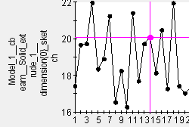
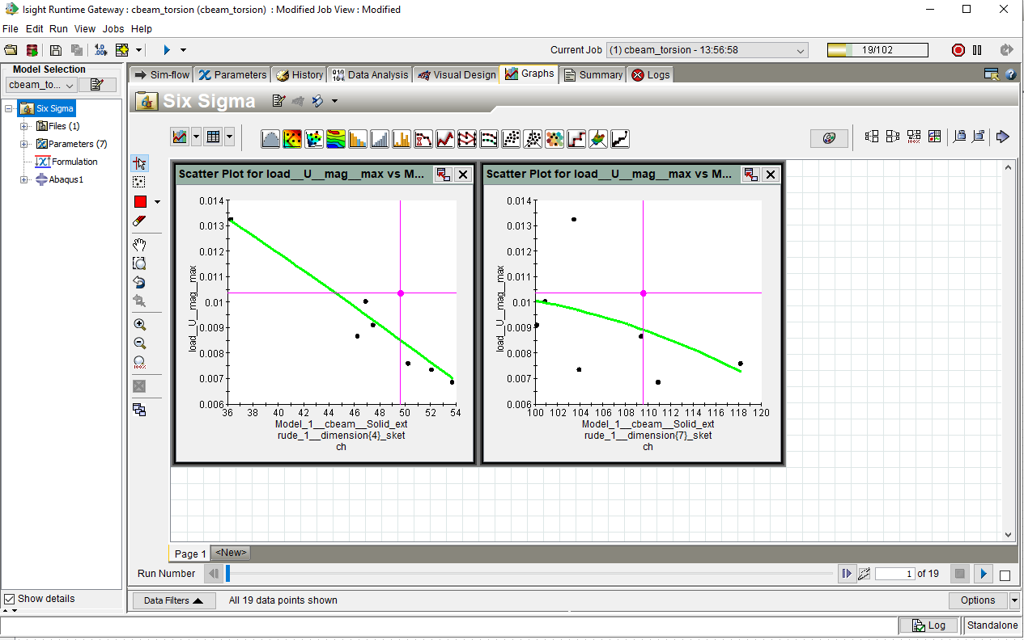
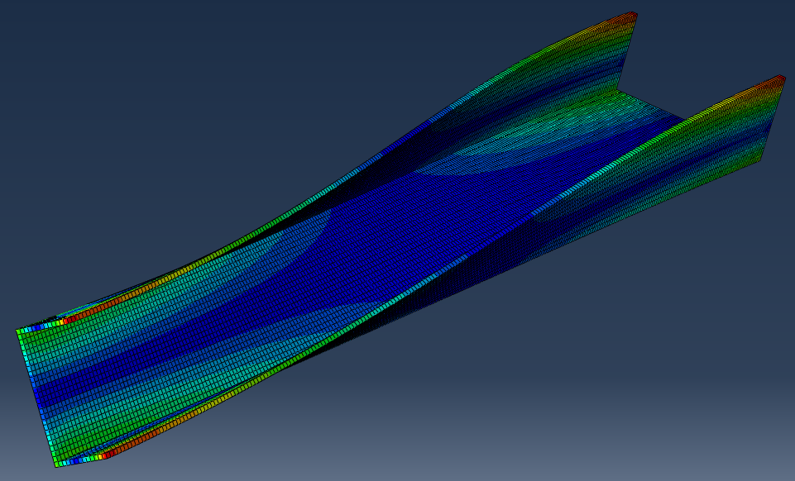
C-beam study
Buckling Test
Refine parameters
Notes:
Post-buckling reliability design (vary lay-up)
Chapter 7: Robust Multilevel Design Optimization of Composite Panels
Robust and Reliability-Based Design Optimization of a Composite Floor Beam

Slide 3
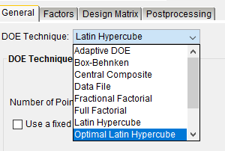

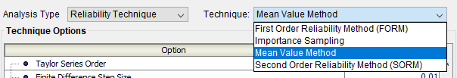
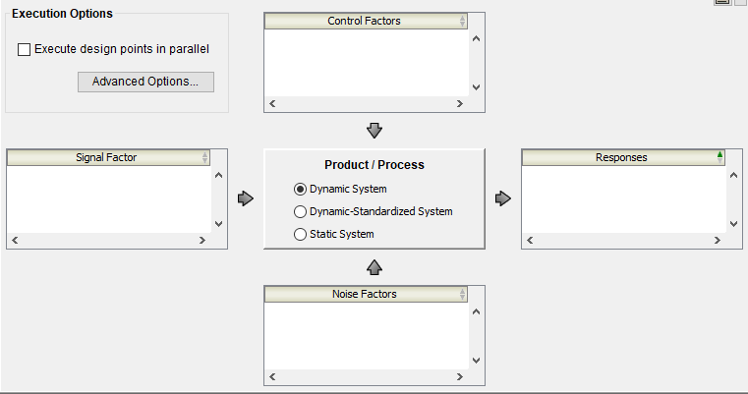
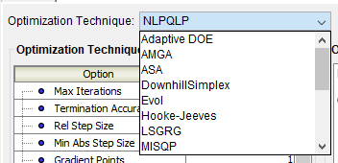
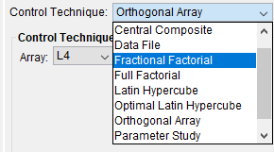
Isight Component Areas
DOE
MCS
Six Sigma (+Reliability)
Taguchi Robust Design
Stochastic Design Improvement
Optimisation

Slide 4
Project plan
Workflow Test Case
Main Test Case
Design Studies
Computation
Final Report Work
Study Flow/ DOE/Statistical Methods
Optimisation Methods
Results Analysis
Analytical Work + Research
Wks 17-19
Wks 1-3
Wks 4-7
Wks 9-16
Week | 1 | 2 | 3 | 4 | 5 | 6 | 7 | 8 | 9 | 10 | 11 | 12 | 13 | 14 | 15 | 16 | 17 | 18 | 19
Month | Jan |  | Feb |  |  |  | Mar |  |  |  |  | Apr |  |  |  | May

Slide 5
